Slide 1
INFORMATION PROCESSING IN ONLINE REVIEW PLATFORMS THROUGH MACHINE LEARNING
Satyam Sharma
MGT 5101:Multivariate Research Methods

Slide 2
Customer Reviews
Do you browse online reviews when you buy specific products or to consume specific services??
Does your business or website depend on reviews to acquire new and to retain existing customers??

Slide 3
Prior Research
Sahoo et al. find one out of every three purchases at online retailers is returned!!
Higher review volume, lower ratings dispersion, and the presence of more “helpful” reviews are all associated with a lower probability of return.
Both helpful reviews and reviews by top reviewers increase sales.

Slide 4

Previous research has found that especially bad hygiene ratings have a significant negative influence on restaurant revenue
Sadilek et al. 2018, Kang et. al. 2013 utilize Twitter messages and text analysis techniques to generate health scores and provide indications that these generated health scores are correlated with the actual health rating.

Slide 5
Health Inspections
Performed by governmental health departments to ensure compliance of restaurants with food safety regulations.
Different aspects related to food handling, food temperature, personal hygiene, facility, etc. are investigated, and, in the case of violations, penalized by means of a bad restaurant health rating.
Restaurant owners are obliged to publicly disclose their health inspection grades prominently in their restaurant windows.

Slide 6
Research QuestionS?
Previous research largely neglected information processing on online review platforms.
The Efficient Market Hypothesis (EMH) by Fama posits that market participants process new information published, trade accordingly, and that, consequently, stock prices react to such new relevant information.

Slide 7
Research QuestionS?
To investigate whether newly published inspection results represent new and relevant information that is noticed by online reviewers and how these inspection results are reflected in online restaurant reviews posted on the online review platform Yelp.

Slide 8
Hypothesis
How are critical restaurant health inspection results reflected in online restaurant reviews?
Is restaurant quality increased in response to critical restaurant health inspection results?
Is there an increase in amount of fake reviews published in response to critical restaurant health inspection results?
What are the overall drivers of information processing on online review platforms?

Slide 9

Data and Descriptive Statistics
Restaurant health inspection data from three cities, that is, Las Vegas, Toronto, and Pittsburgh.
Sample of 40,834 restaurant reviews posted on Yelp around 2,126 non-overlapping restaurant health inspections of 1,570 restaurants.

Slide 10






Methodology
Volume of Reviews
Average Star Rating
Average Emotiveness of reviews
Feng et al. (2012) have shown overtly skewed bimodal
distributions can be a telltale sign of deceptive reviews.

Slide 11

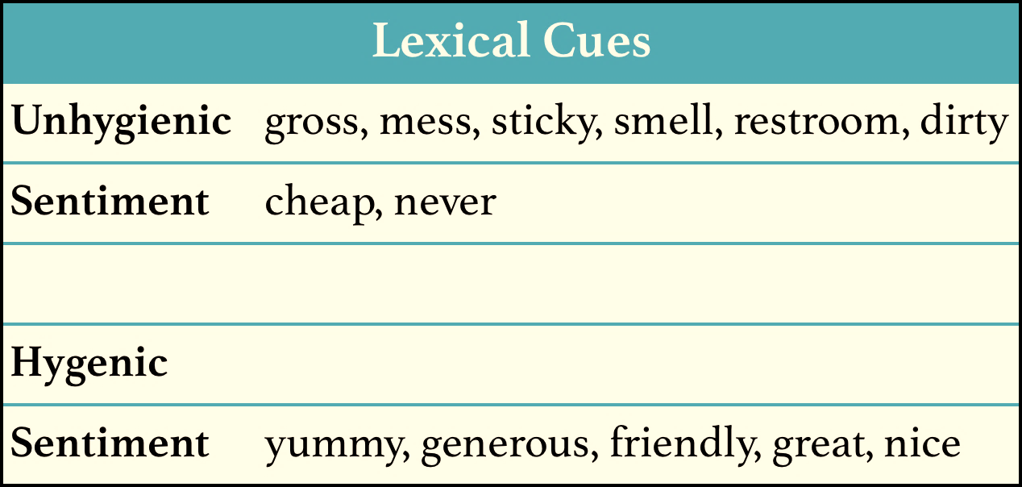
Lexical Cues

Slide 12
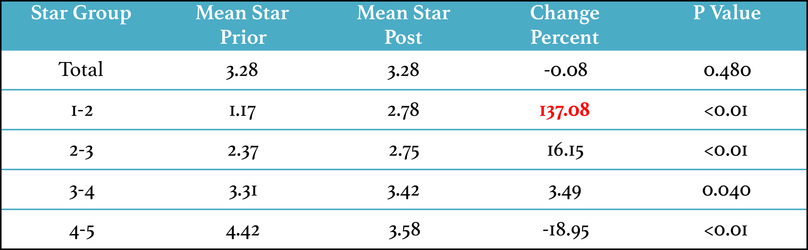
Results-Toronto

Slide 13
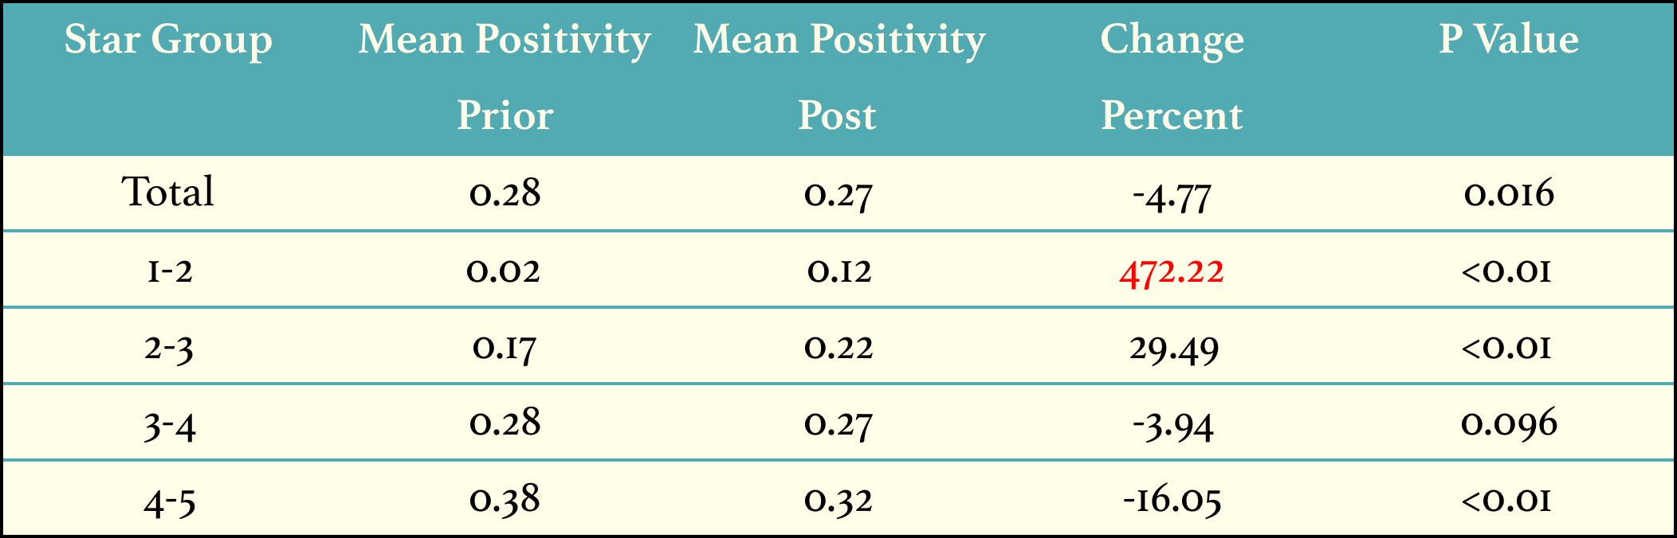

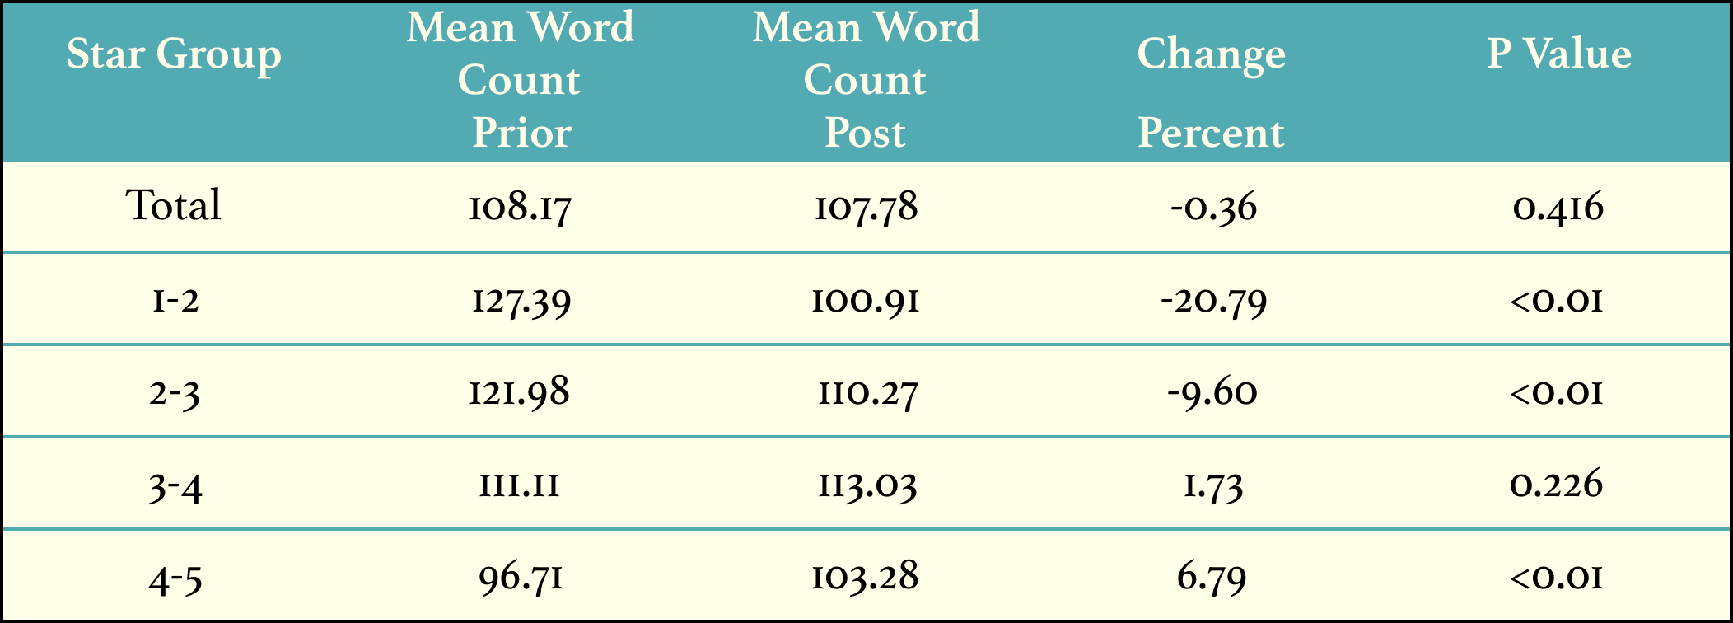
Results-Toronto
Fake Reviews
Driving results?

Slide 14

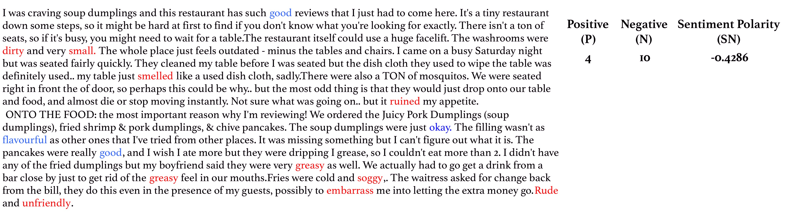
Variable Extraction
SN=(P-N)/(P+N)

Slide 15
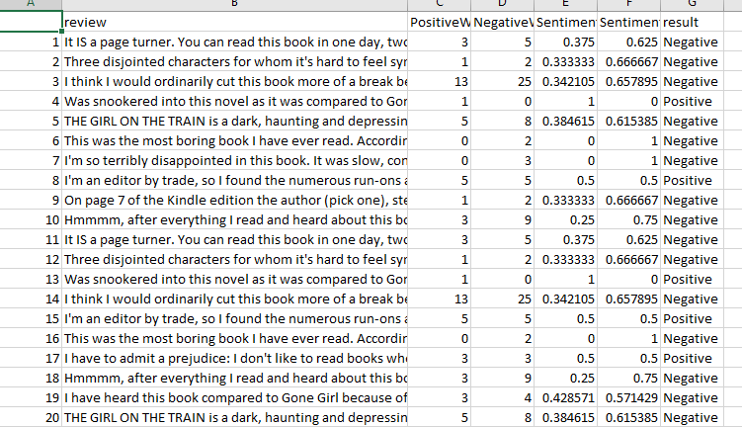
Spreadsheet Example

Slide 16
Fake Reviews
Positive deceptive reviews are generally more positive and negative deceptive reviews were more negative in sentiment when compared with the truthful reviews generated by actual customers [6].

Slide 17
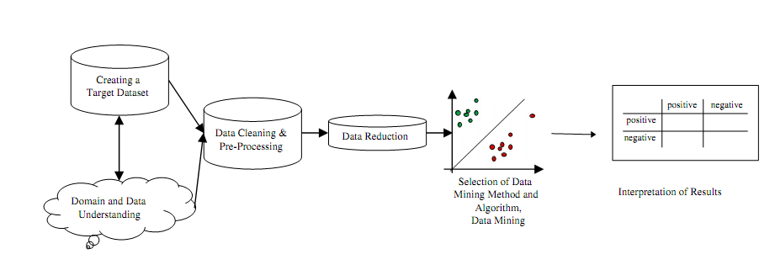
Classification of deceptive reviews

Slide 18
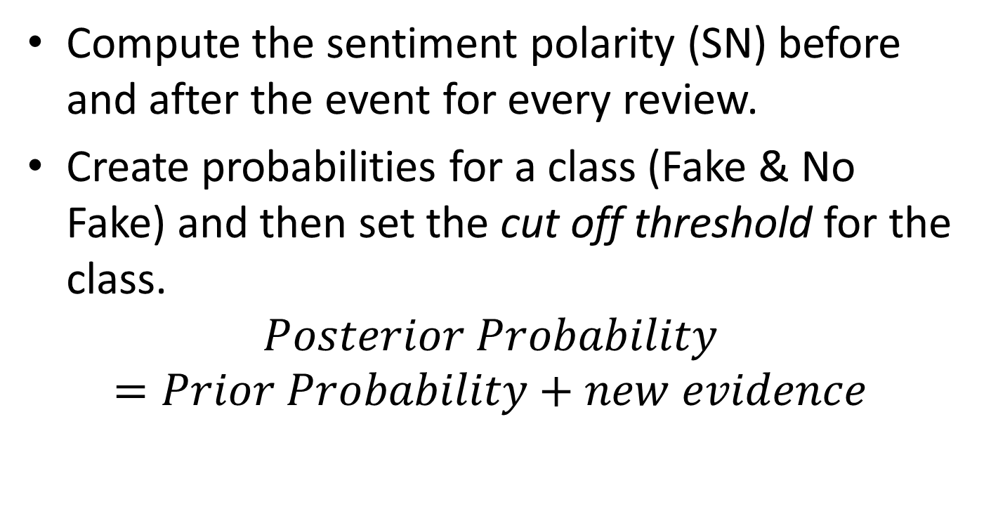
Classification of Fake Reviews-Methodology
Compute the sentiment polarity (SN) before and after the event for every review.
Create probabilities for a class (Fake & No Fake) and then set the cut off threshold for the class.
$$Posterior Probability=Prior Probability+new evidence$$

Slide 19
Classification of Fake Reviews-Methodology…
Where prior probability is calculated from the training data set and posterior probability is the probability after classification of test data.
Optimize for precision: TP/(TP+FP) and recall: TP/(TP+FN) by varying the threshold.
The results can be then tested for significance.

Slide 20
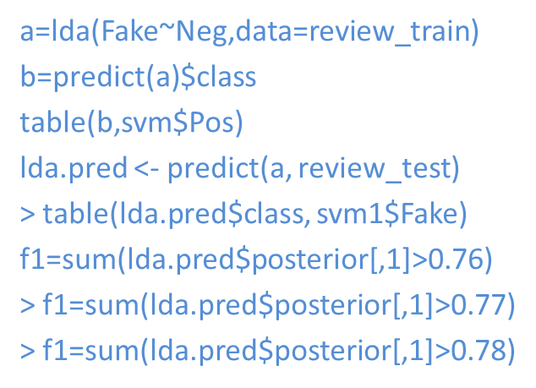
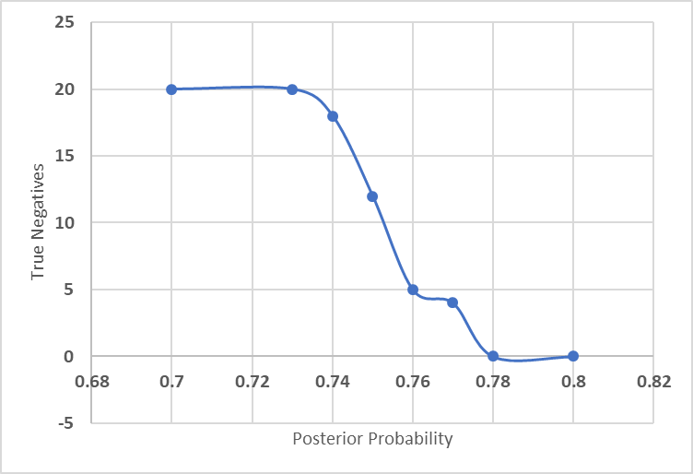
Implementation in R using LDA

Slide 21
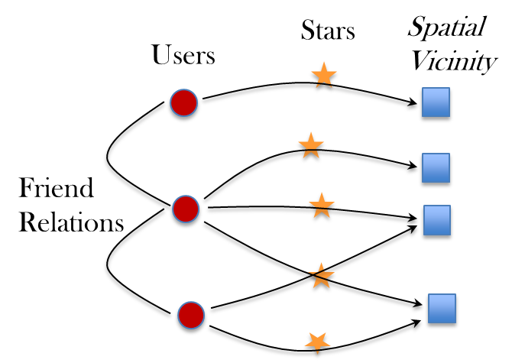
Fake Reviews-Other Ways of Detection

Slide 22
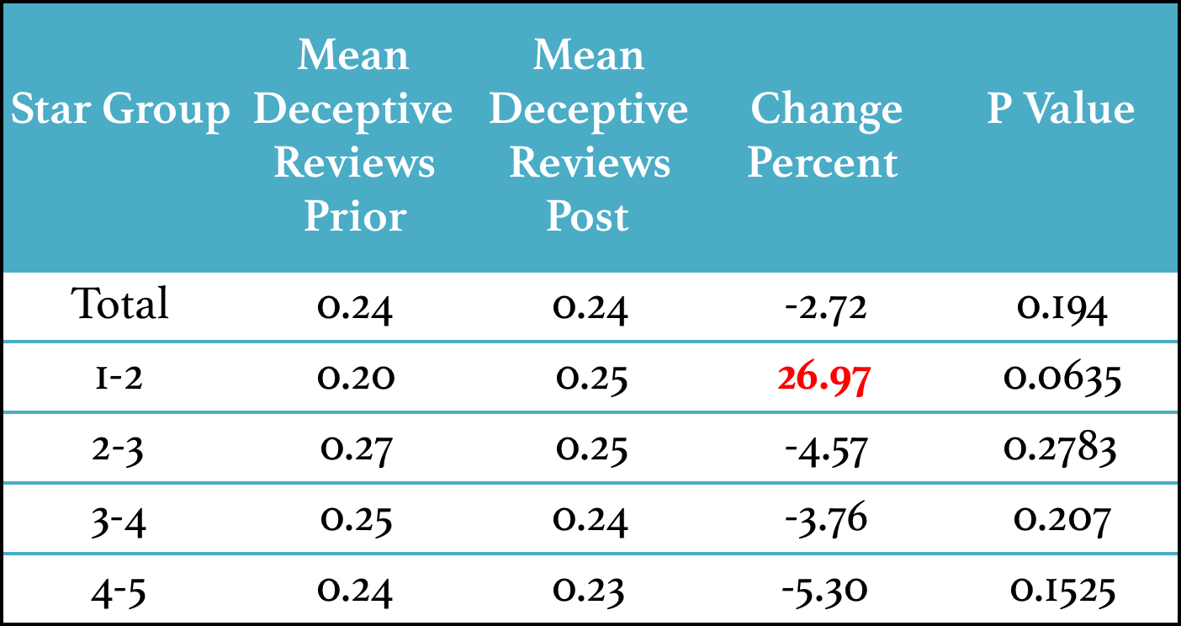
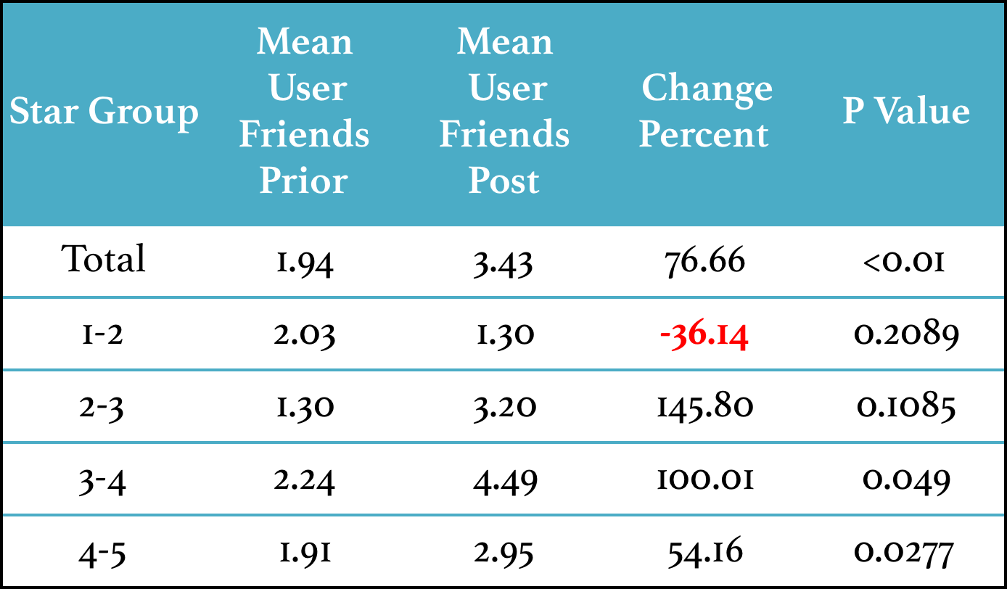
Left: Results from Classification
Right: Results from Friends count

Slide 23
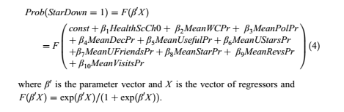
Drivers of Information Processing
A logistic regression with StarDown as the binary dependent variable. StarDown is defined as 1 if the mean star rating decreases after the critical health inspection. Otherwise, StarDown is defined as 0.

Slide 24
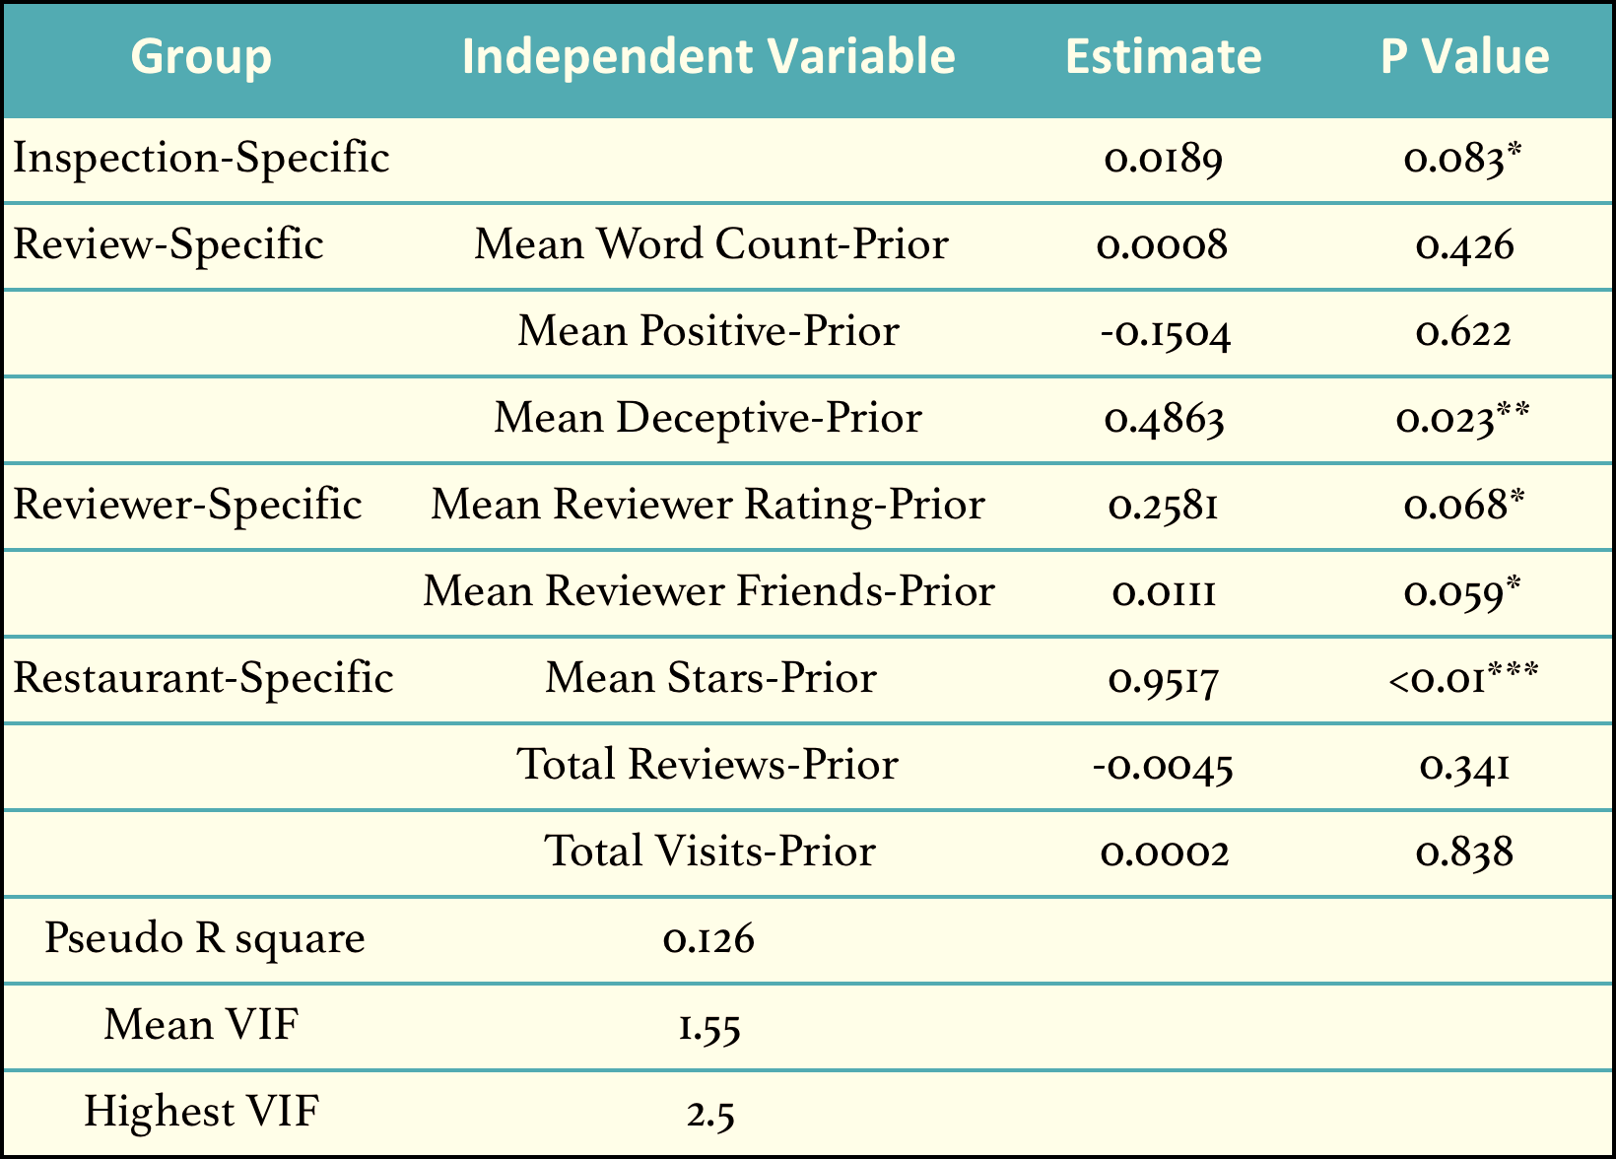
Results-Logistic Regression

Slide 25
Conclusions
There is a statistically significant impact of critical health inspection results on online review star ratings.
Critical health inspections trigger improvements in restaurant quality, but also contribute to an increased amount of fake reviews in lower star groups.
In environments with a high number of fake reviews, a critical health inspection result is perceived as more surprising or a shock. Thus, it is translated into a lowering star rating. Hence, amount of fake reviews has a positive influence on the probability that the star rating decreases.
If the amount of inspection demerits increases, the probability of decrease in star rating is higher.

Slide 26
References
Kang, J.S; Kuznetsova, P; Luca, M; and Choi, Y. Where not to eat? Improving public policy by predicting hygiene inspections using online reviews. Proceedings 2013 Conference Empirical Methods Natural Language Process, 2013 (2013), 1443–1448
Sadilek, A; Brennan, S; Kautz, H; and Silenzio, V. nEmesis: Which restaurants should you avoid today? First AAAI Conference on Human Computing and Crowdsourcing, 2013. 55.
* Clapham, B., Siering, M., & Gomber, P. (2019). Popular News Are Relevant News! How Investor Attention Affects Algorithmic Decision-Making and Decision Support in Financial Markets. Information Systems Frontiers, 1-18.
* Sahoo, N; Dellarocas, C and Srinivasan, S. The Impact of online product reviews on product returns. Information Systems Research, 29, 3 (2018), 723–738.
* Fama, E.F. Efficient Capital Markets: A Review of Theory and Empirical Work. The Journal of Finance, 25, 2 (1970), 383–417.
* Siering, M., & Janze, C. (2019). Information Processing on Online Review Platforms. Journal of Management Information Systems, 36(4), 1347-1377.
* Groth, S. S., Siering, M., & Gomber, P. (2014). How to enable automated trading engines to cope with news-related liquidity shocks? Extracting signals from unstructured data. Decision support systems, 62, 32-42.
* Clapham, B., Siering, M., & Gomber, P. (2019). Popular News Are Relevant News! How Investor Attention Affects Algorithmic Decision-Making and Decision Support in Financial Markets. Information Systems Frontiers, 1-18.
* Q1 Journal Article

